Slide 1
Python Tutorial Series 2019 Your code pretty and Healthy
Ph.D. Bruno C. Quint – bquint@gemini.edu
NSF’s National Optical-Infrared Astronomy Research Laboratory

Slide 2
Contents
Code Style
Documentation
Testing
Project Structure
Versioning and Version Control

Slide 3
Introduction

Slide 4
Code Style
The Zen Of Python
>>> import this
...
Explicit is better than implicit.
Simple is better than complex.
Complex is better than complicated.
Flat is better than nested.
Sparse is better than dense.
...

Slide 5
Code Style – The PEP8
Why write if others can’t read?

Slide 6
Code Style – The PEP8
Why write if others can’t read?

Slide 7
Code Style – The PEP8
Why write if others can’t read?
Importing packages
Don’t
Identation – Always use (four) spaces
from numpy import *
for i in range(10):
....x = i * 2
....print(x)
Do
import numpy as np

Slide 8
Code Style – The PEP8
Why write if others can’t read?
GLOBAL_VARIABLE_NAME = "example"
variable_name = 5
def function_name(x, y):
....return x + y
class ClassName:
....
....def method_name(self):
........(do something)
space
Two empty
lines
before
functions
and classes
space
space
Spaces between
operators and
characters
space

Slide 9
Code Style – Tools
Why write if others can’t read?
Tools for code format
PyLint
flake8
Black
PyCharm CE

Slide 10
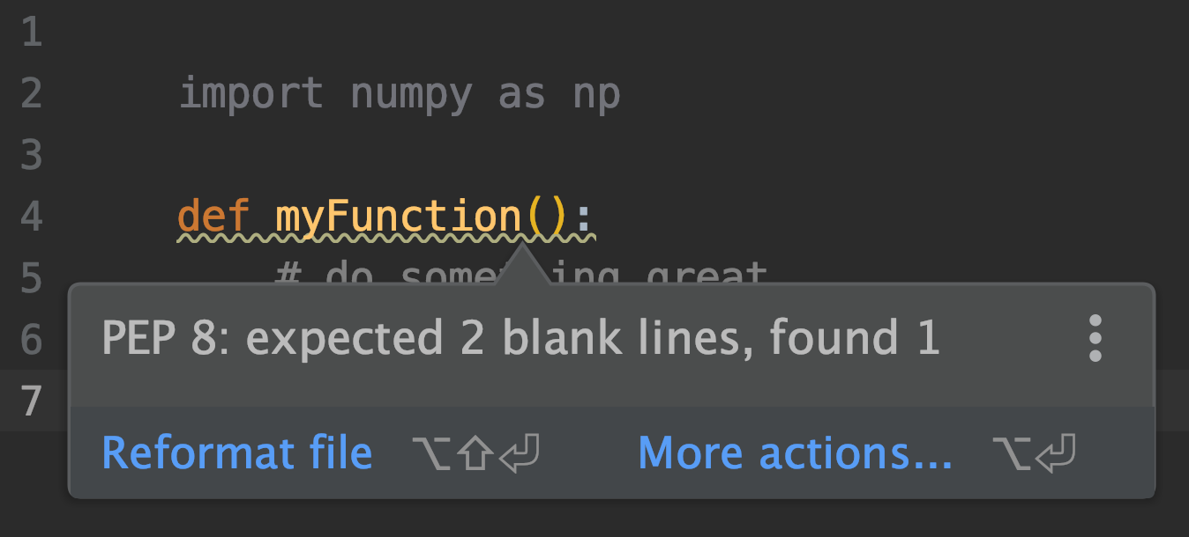
Code Style – Tools
Why write if others can’t read?

Slide 11
Documentation
#!/usr/bin/env python
# -*- coding: utf-8 -*-
"""
My Sample Code
This is such a simple documentation! The only thing I have to do is to add three single quotes (') or double quotes (") together to start a docstring block! Then just write down in a few words what you want to do in your file.
by J. Bond - Feb 31, 202X
"""

Slide 12
Documentation
#!/usr/bin/env python
# -*- coding: utf-8 -*-
"""It is ok if the docstring is just one line"""

Slide 13
Documentation
def say_hello(name):
"""
This function says hello to the person whose name
is given as parameter.
"""
print("Hello, {0}!".format(name))

Slide 14
Documentation
The NumPy Style
def say_hello(name):
"""
When adding documentation, think of “What?”,
“Why?” and “How?”.
Parameters
----------
name : str
Name of the person you want to greet.
"""
print("Hello, {0}!".format(name))

Slide 15
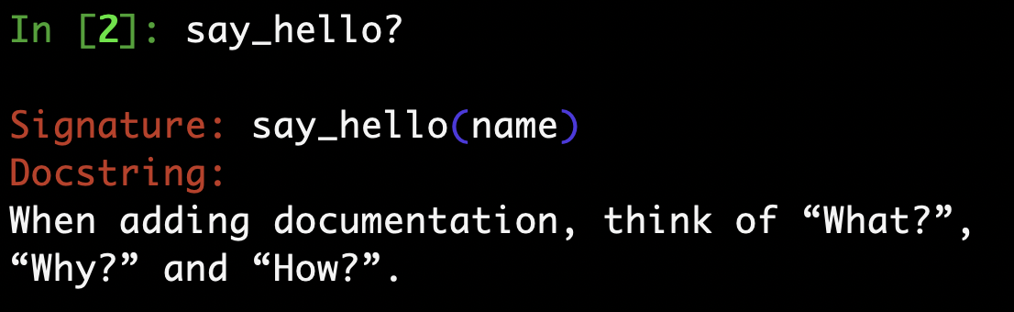
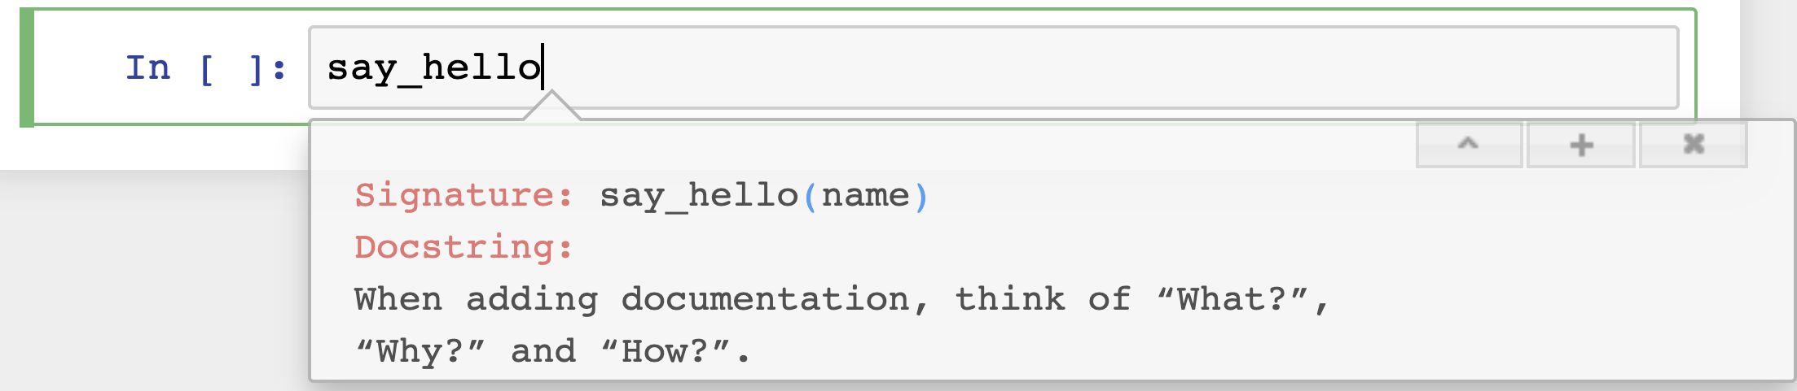
Documentation

Slide 16
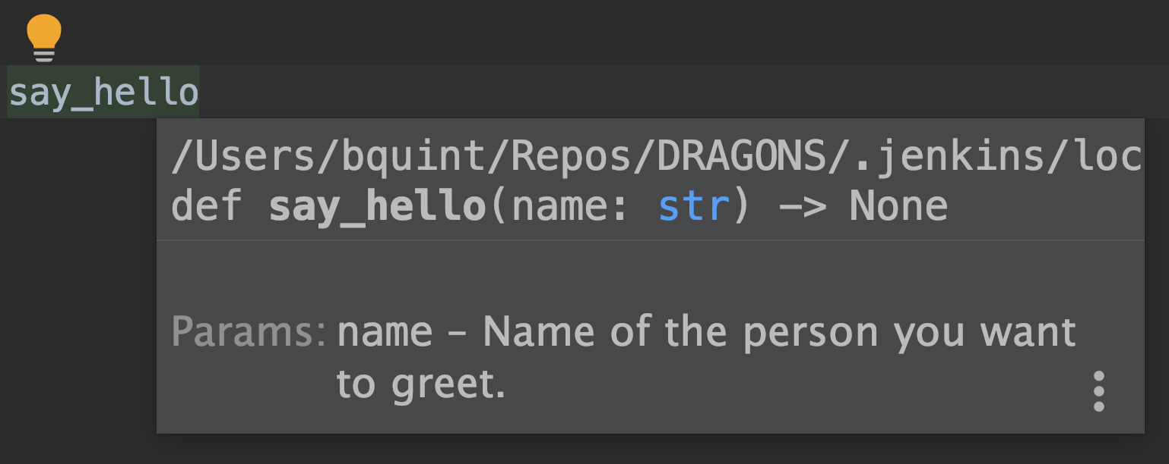
Documentation

Slide 17

Testing
The refactoring cat

Slide 18
Testing
Test-Driven Development
The refactoring cat
Test Fails
Test Passes
Refactor

Slide 19
Testing
Tools for code format
unittest
nosetest
pytest
numpy.testing
Tests can be top simple top-level functions
Simple result assertion
Fixtures provide modularized test suite
Tests can be easily parametrized

Slide 20
Testing
# contents of test_capital_case.py
from manipulate_strings import capital_case
def test_capital_case(): assert capital_case('semaphore') == 'Semaphore'

Slide 21
Testing
# contents of test_capital_case.py
from manipulate_strings import capital_case
def test_capital_case(): assert capital_case('semaphore') == 'Semaphore'
# contents of manipulate_strings.py
def capital_case(my_str): return my_str.capitalize()

Slide 22
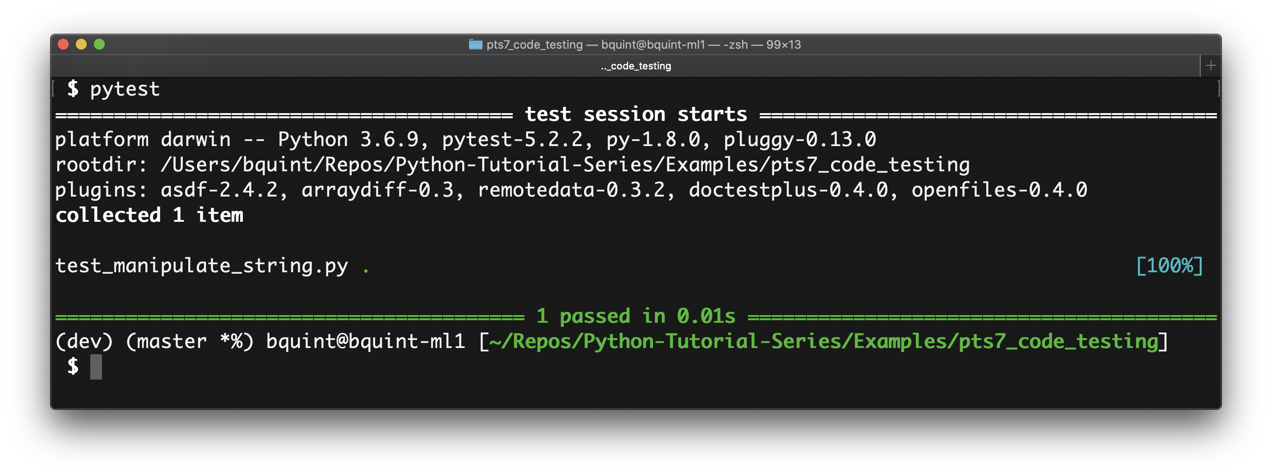
Testing

Slide 23
Testing
# contents of test_capital_case.py
...
def test_raises_exception_on_non_string_arguments():
with pytest.raises(TypeError):
capital_case(9)

Slide 24
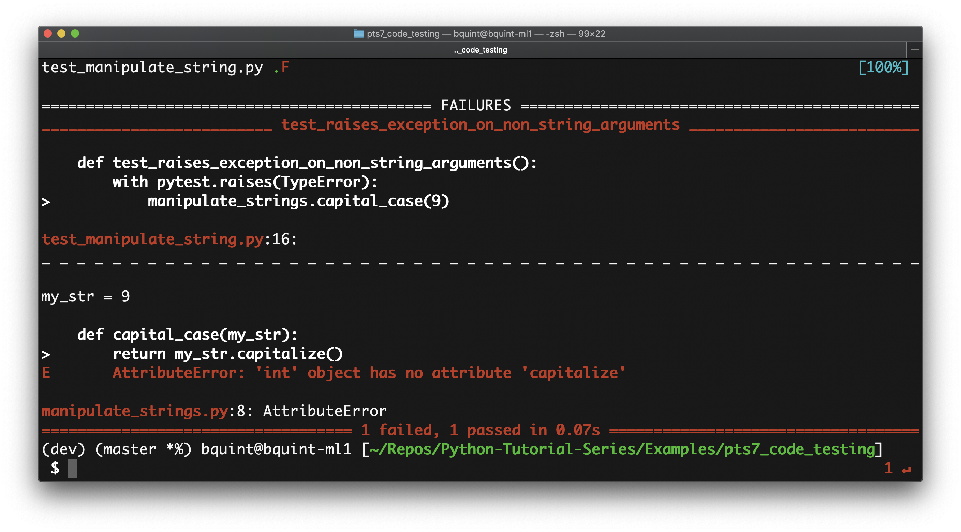
Testing

Slide 25
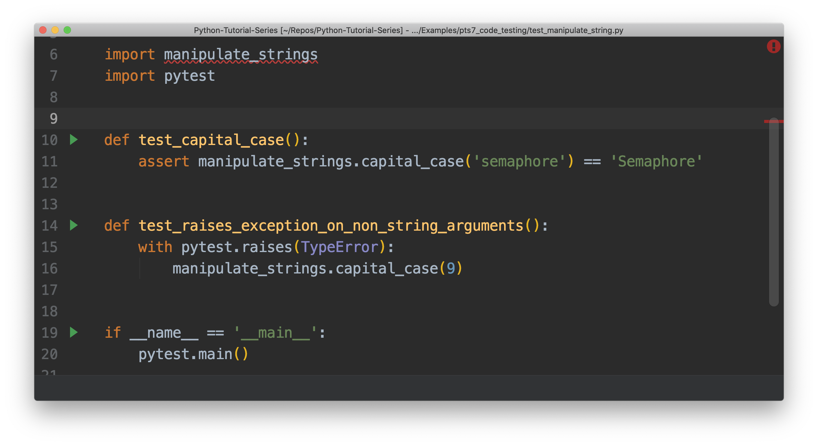
Testing

Slide 26
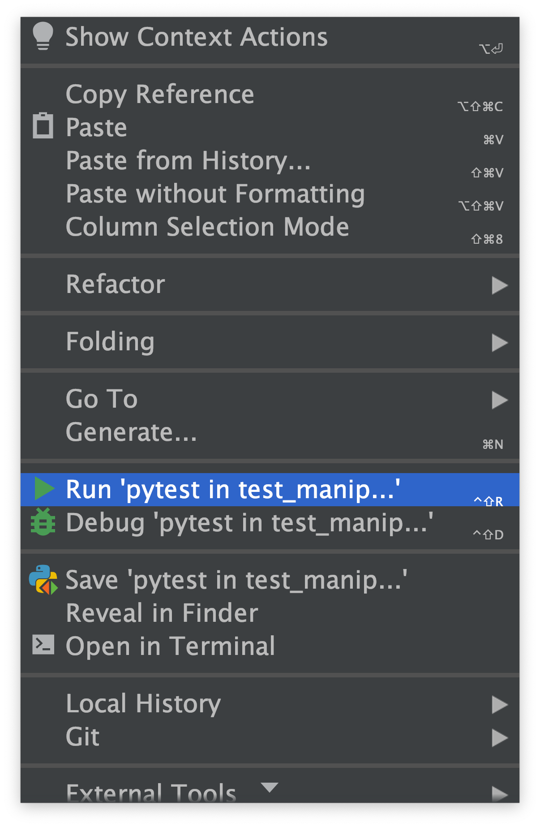
Testing

Slide 27
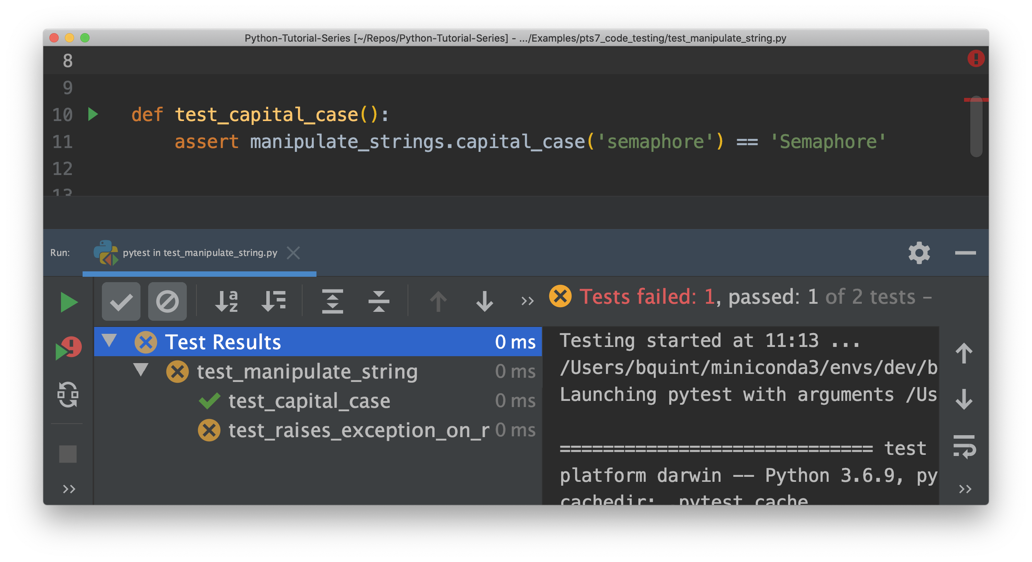
Testing

Slide 28
Testing
def test_can_perform_task(_):
...
assert test_was_performed()
Yes
def test_cpt(_):
...
assert test_was_performed()
No
def test_1(_):
...
assert test_was_performed()
NEVER!!!

Slide 29
Project Structure
+--- README.rst
+--- LICENSE
+--- setup.py
+--- requirements.txt
+--- docs/
| +--- conf.py
| +--- index.rst
...
+--- sample/
| +--- __init__.py
| +--- core.py
| +--- helpers.py
...
+--- tests/
| +--- __init__.py
| +--- conftest.py
| +--- test_core.py
...

Slide 30
Project Structure
+--- README.rst
+--- LICENSE
+--- setup.py
+--- requirements.txt
+--- docs/
| +--- conf.py
| +--- index.rst
...
+--- sample/
| +--- __init__.py
| +--- core.py
| +--- helpers.py
| +--- tests/
| | +--- __init__.py
| | +--- conftest.py
| | +--- test_core.py
...

Slide 31
Project Structure
+--- README.rst
+--- LICENSE
+--- setup.py
+--- requirements.txt
+--- .gitignore
+--- bin/
+--- scrips/
+--- docs/
| +--- conf.py
| +--- index.rst
...
+--- sample/
| +--- __init__.py
| +--- core.py
| +--- helpers.py
| +--- tests/
| | +--- __init__.py
| | +--- conftest.py
| | +--- test_core.py
...

Slide 32
Project Structure
setup.py
Using setuptools
# contents of setup.py
from setuptools import setup, find_packages
setup(
name="HelloWorld",
version="0.1",
packages=find_packages(),
)

Slide 33
Project Structure
setup.py and setup.cfg
Using setuptools
# contents of setup.cfg
[metadata]
name = HelloWorld
version = 0.1
[options]
packages = find:
# contents of setup.py
from setuptools import setup, find_packages
setup()

Slide 34
Project Structure
$ putup my_project
$ ls my_project
AUTHORS.rst requirements.txt
CHANGELOG.rst setup.cfg
LICENSE.txt setup.py
README.rst src
docs tests
Link to PyScaffold documentation

Slide 35
Versioning and Version Control
Semantic Versioning 2.0.1
MAJOR version when you make incompatible API changes
MINOR version when you add functionality in a backwards compatible manner
PATCH version when you make backwards compatible bug fixes.
Calendar Versioning 2019.0.1
YYYY format year of release
MINOR release version
PATCH version

Slide 36
Versioning and Version Control
Git Online Book (free)
GitLab
(paid – available for Gemini Users)
GitHub (free)
PyCharm CE (free)
GitKraken (free)

Slide 37

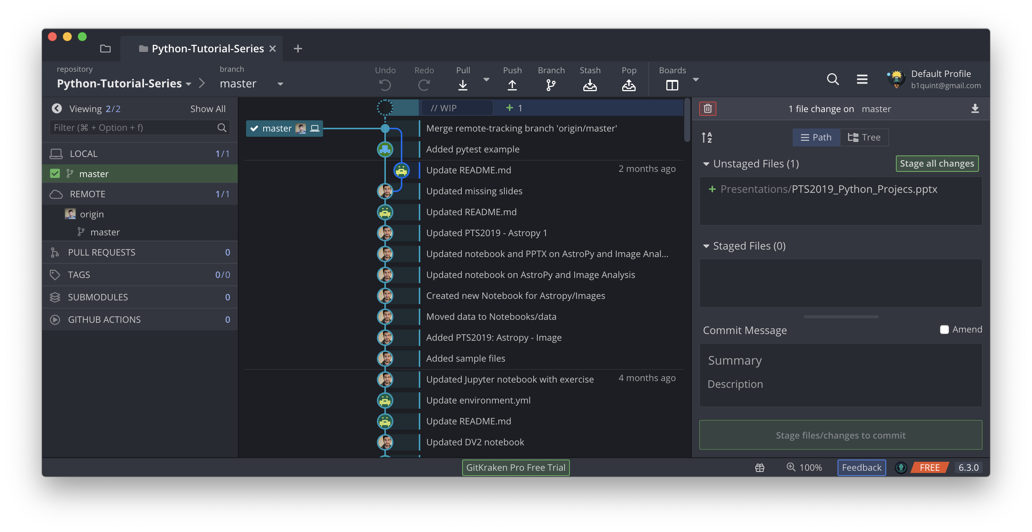
Versioning and Version Control

Slide 38
Versioning and Version Control

Slide 39
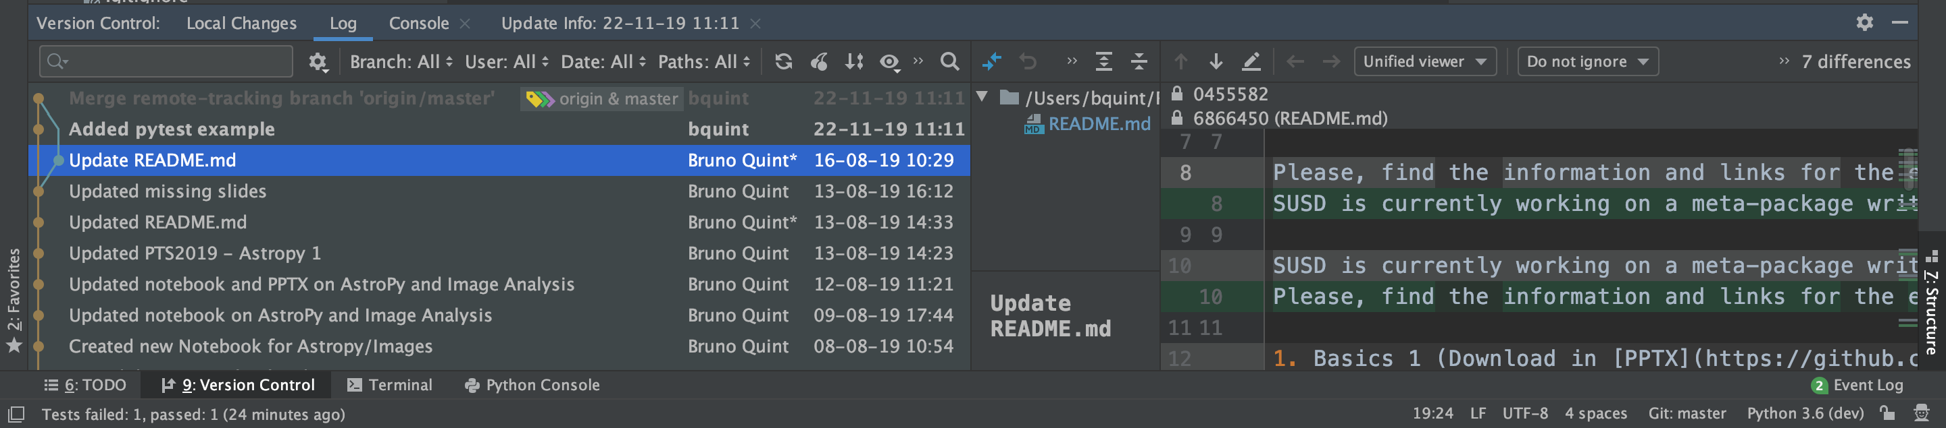
Versioning and Version Control

Slide 40
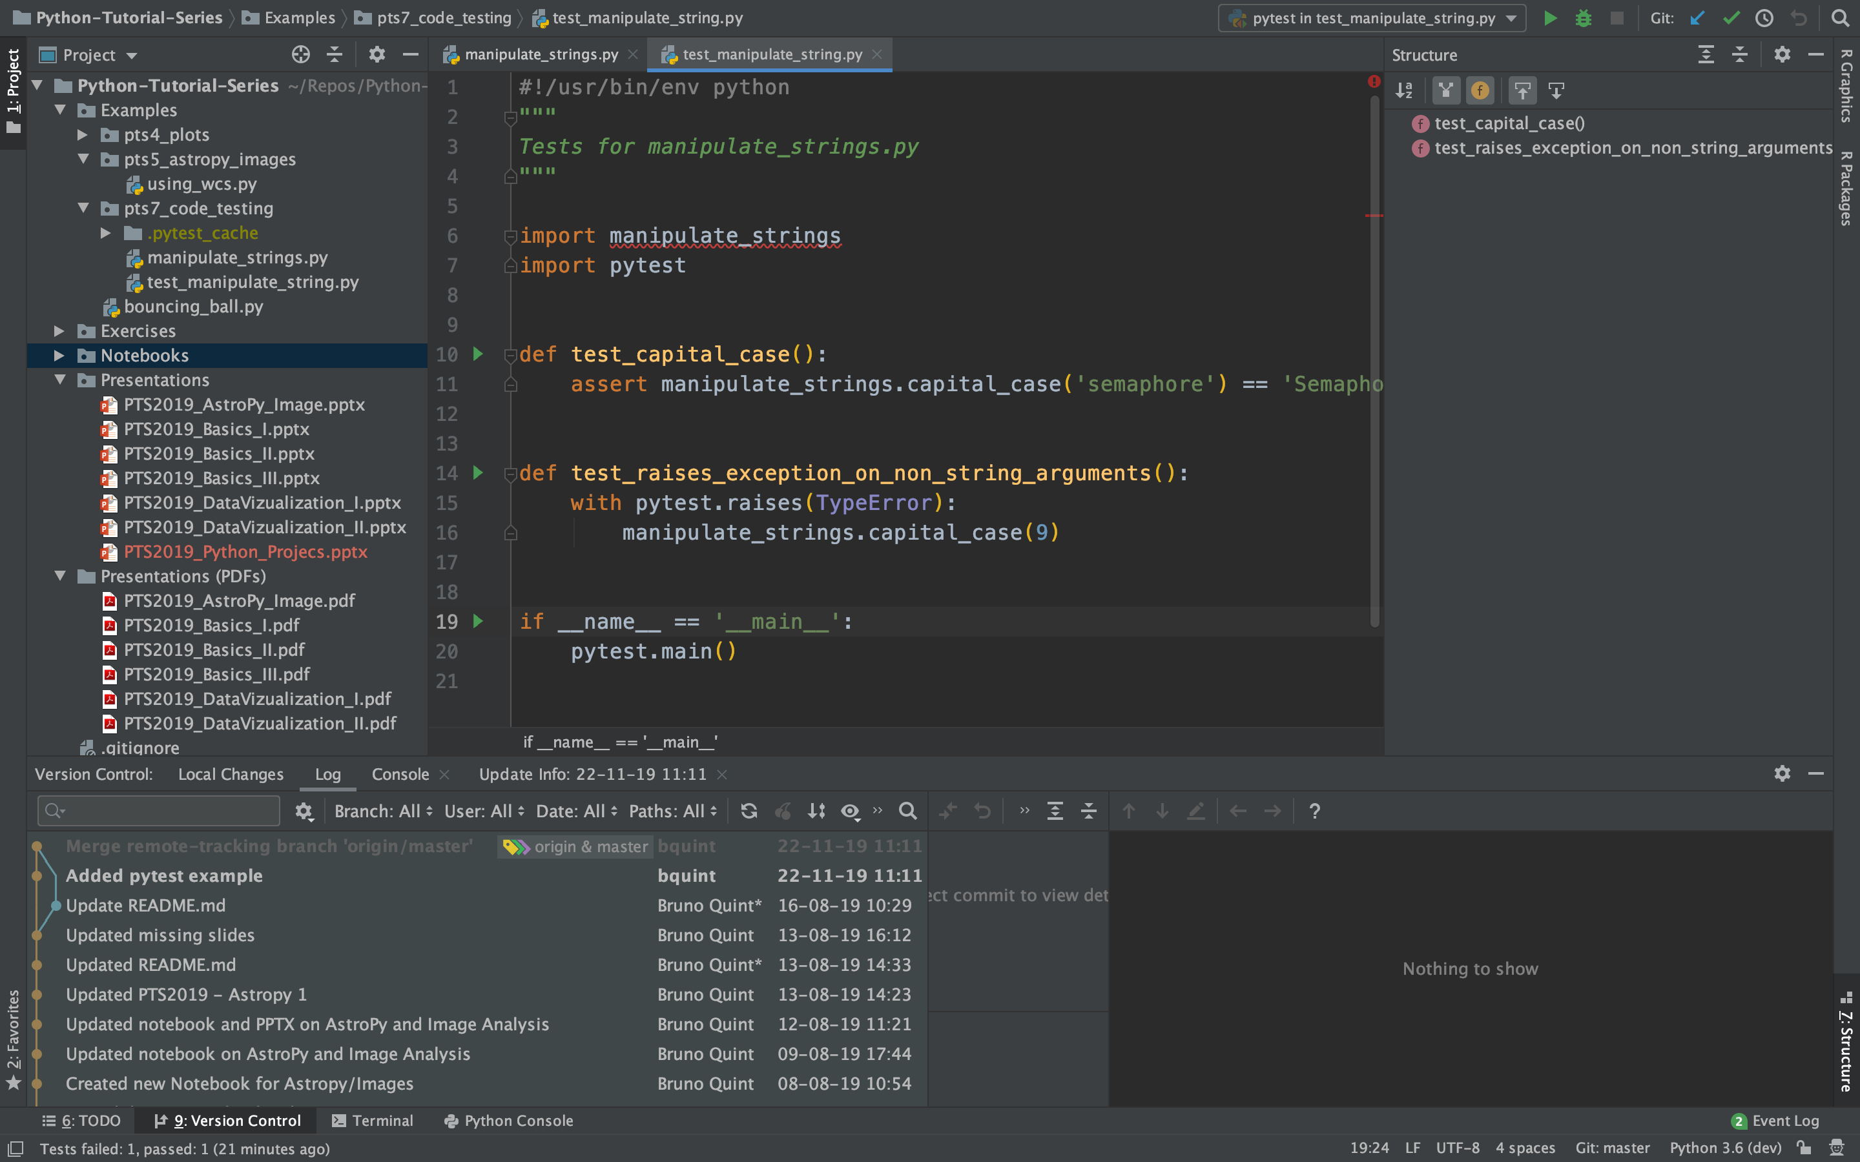

Slide 41
Versioning and Version Control
Write meaningful commit messages
https://xkcd.com/1296/

Slide 42
Before you go...
package
Rule of 3
Three strikes and you refactor
Duplication: hard to maintain
Seeing some cases helps code design
30 classes max
x
classes
30 methods max
x
methods
Rule of 30
If an element consists of more than
30 subelements, it is highly probable that
there is a serious problem.
30 lines of code
27000 lines of code

Slide 43
Before you go...
def snellsLaw(n, t):
return np.rad2deg(np.arcsin(np.sin(np.deg2rad(t))/n))

Slide 44
Before you go...
def snells_law(incident_angle, refractive_index):
""" ... """
theta = np.deg2rad(indicent_angle)
n = refractive_index
temp = np.sin(theta) / n
temp = np.arcsin(theta)
output_angle = np.rad2deg(temp)
return output_angle

Slide 45
Questions?
?
?

